Slide 1
Techonetes: Hackathon
Team Name: Techjunkies
Team Members:-
Leader: Kunal Birla(Btech-Cse,1st year)
Anuj Chhabra(Btech-Cse,1st year)
Harshit Garg(Btech-Cse,1st year)
College Name:- Delhi Technical Campus

Slide 2
Problem Statement:- 1. Remote communication (Description: In today’s post-pandemic world remote work has become the norm but still, there are many issues with today’s remote work infrastructure in India such as poor network connectivity and etc. your job is to come up with a creative solution to make the process of remote work easier ).

Slide 3
Idea Details
The main problem that is faced by people in remote work is communication. So aiming this our idea is to create an application that will help all the employees to know which person is active/online at that particular moment.
Basically we are creating a virtual punching machine which will enable the employees to mark their presence and in particular we are adding some more features which are as follows:-
•We will add features which will show who is online at that moment
and who is not.
•All the employees will be getting notification when other co-workers will
come online.

Slide 4
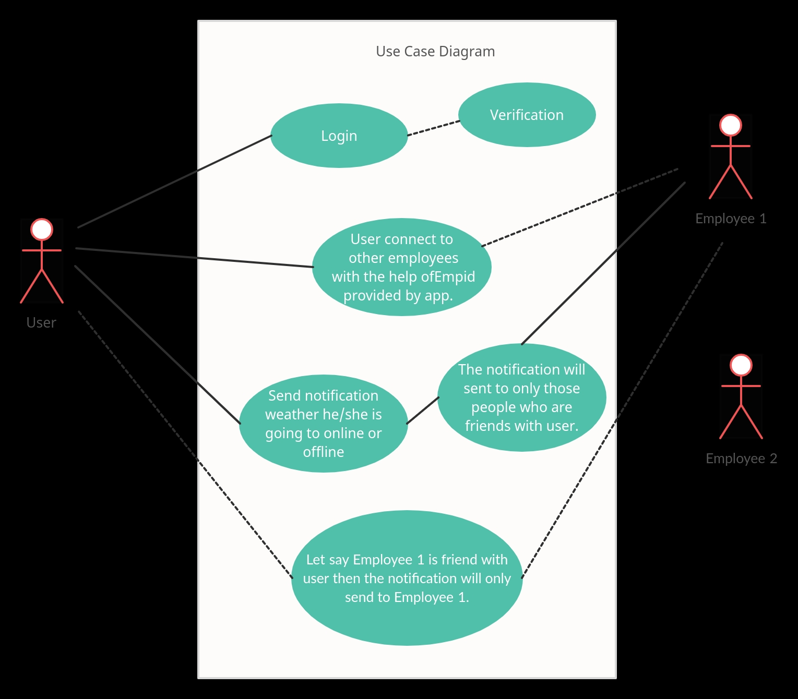
Case Diagram:-
Making Connections

Slide 5
Some other add on’s:-
We will adding one more features through which the employees can put themselves offline whenever they will be going to lunch and other stuff and the reason will also be stated that where they are going. We will pe putting various options for being offline like:-lunch,dinner, other important work,etc.
Pros of our idea:-
■ This will make the communication easier.
■ No misunderstandings will be created among employees.

Slide 6
Thankyou

